Slide 1


Title I Annual Parent Meeting
The Boca Ciega High School
September 12th
6 p.m.
Student Activities Center
Principal, Jennifer Gil
Notes:
Evidence: Upload completed presentation and recorded feedback as part of the evidence to support the Annual Meeting Materials. Do not forget the sign-in sheets, and survey/feedback that you receive throughout the meeting.

Slide 2

All About Title I
Title I is the largest federal assistance program for our nation’s schools.
Title I is the largest federal assistance program for our nation’s schools.
The program serves 75 schools in Pinellas County including eligible students in 36 non-public schools.
Notes:
Highlight the Title I Program here in Pinellas County.

Slide 3
Title I Funding Process
Pinellas County Schools
Increased Student Achievement
Federal Government
1
3
2
4
Florida Department of Education
Boca Ciega High School
Notes:
The Florida Department of Education receives funds from the federal government. Districts receive Title I funds from Department of Education, and the school district distributes these funds to schools based on the percentage of children eligible for free/reduced price lunch; however, students do not have to be from low-income families to receive help.

Slide 4

Supplemental Resources
Definition: provided in addition to what is already present or available to complete or enhance it.
https://languages.oup.com/
Notes:
Title I is supplemental federal funding that provides e
Definition: provided in addition to what is already present or available to complete or enhance it extra academic support and learning opportunities for economically disadvantaged students.

Slide 5
Title I Schoolwide Planning and Input
First
Second
Last
Seek Input from school, family, and community members determine how Title I funds are used based on a needs assessment.
Please attend online or in-person meetings/trainings and complete surveys to provide input on Title I funding.
All Title I schools must document that parents are involved in the schoolwide planning process.
Notes:
Evidence for input – input from school can be a survey or notes, which include quotes related to what was shared as feedback AND how this input will be used to inform the PFEP and future engagement activities.
Evidence of Attendance – please include attendance of DIVERSE stakeholder group/s.

Slide 6

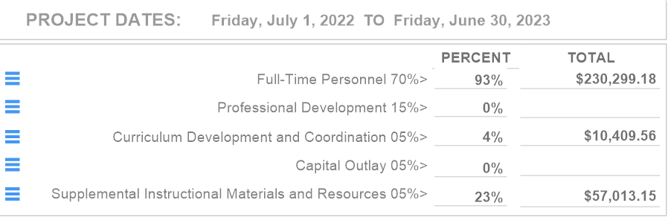
Title I Schoolwide Budget
Boca Ciega High School is provided $248,762 to pay for supplemental resources and programs for increased student achievement which include:
MTSS Coach
Algebra and Geometry Interventionist
Family & Community Liaison
Instructional Materials
Collaborative Planning Hours
Parent Data Chat Nights.

Slide 7
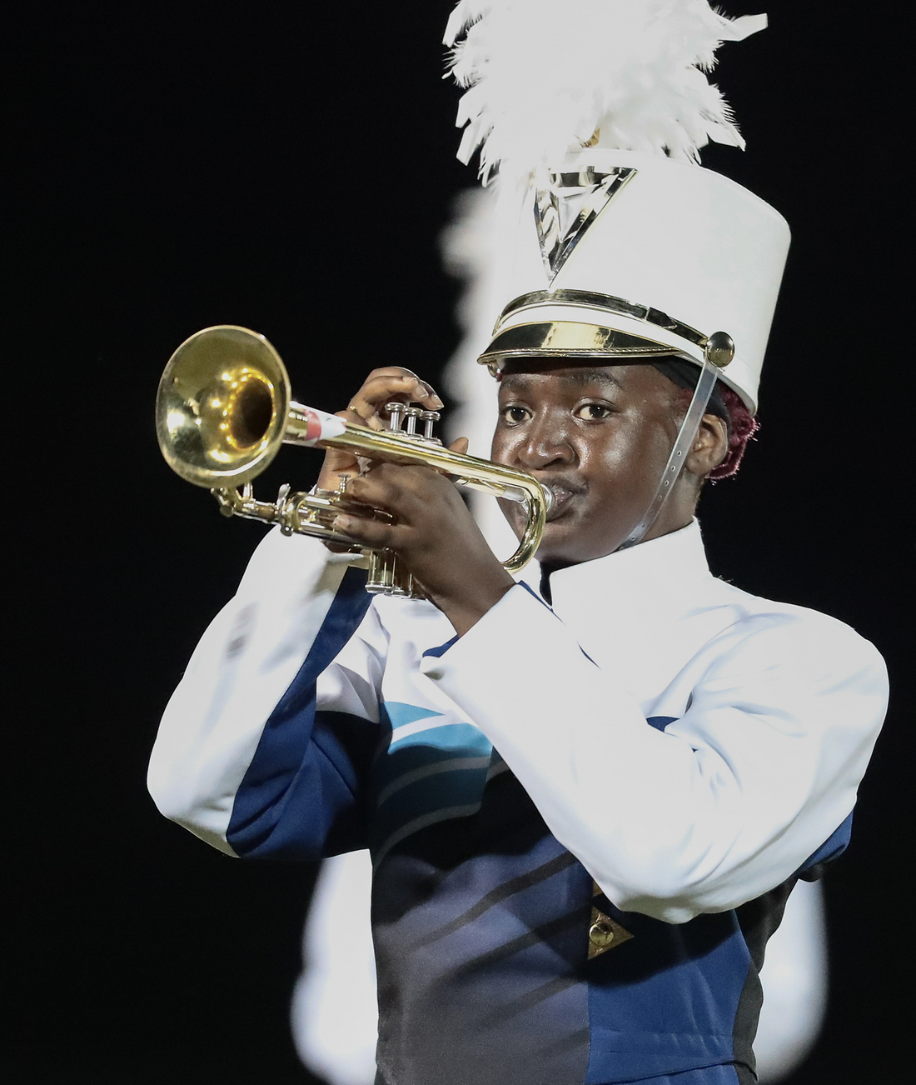
Parent’s Right to Know
As a parent of a student attending a Pinellas County School Public School, you have the right to…
Be
Be provided information on your child’s level of achievement on assessments in Reading/Language Arts, Writing, Mathematics, and Science.
Request and Receive
Request and receive information on the qualifications of your child’s teacher and supplemental personnel working with your child.
Be
Be notified of non-highly qualified or out-of-field teachers at the school.
Be
Be informed if your child is taught by a non-highly qualified teacher for four or more consecutive weeks.

Slide 8
Working Together for Student Success
As a Title I parent you have the right to be involved in the development of the following plans and documents for our school which can be found on our website to view as well as in the Parent Station located in the Family & Community Liaison Office.
School Improvement Plan (SIP)
Title I Schoolwide Plan
Parent and Family Engagement Plan (PFEP)
School-Parent-Student Compact
Notes:
Our school’s Title I Parent Station is located (insert location or photo of Title I Parent Station (front office and on the webpage). Please include photo as part of the evidence monitoring.
You will find a copy of our School Improvement Plan, Title I Schoolwide Plan, School’s PFEP, the School District’s PFEP, Parent’s Right to Know Memo, Upcoming Events, Compact, (insert other documents at your station)

Slide 9

Parent-School-Student Compact
The purpose of the compact is to foster student achievement. By signing the Parent-School-Student Compact, Boca Ciega High School, teachers, staff, parents and students agree to work together to share the responsibility of helping students meet or exceed state, district and school academic goals.
The Parent-School-Student Compact is updated every year to include parent, student, teacher, and staff input. Parent, student, teacher and staff comments are welcome at any time during the year.
Please review and sign your child’s Compact.
Our goal is to receive 100% signed compacts!
Notes:
At the elementary level, school compacts are used as a progress monitoring tool through the year during parent teacher conferences.

Slide 10
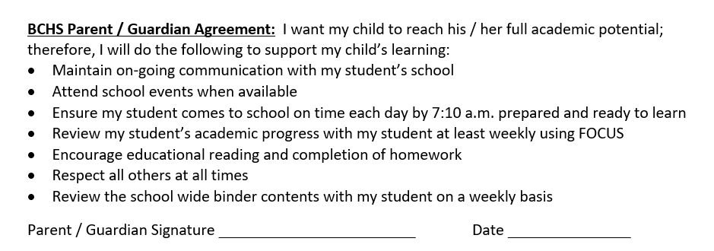
Notes:
Highlight any things that unique to your school’s compact.

Slide 11
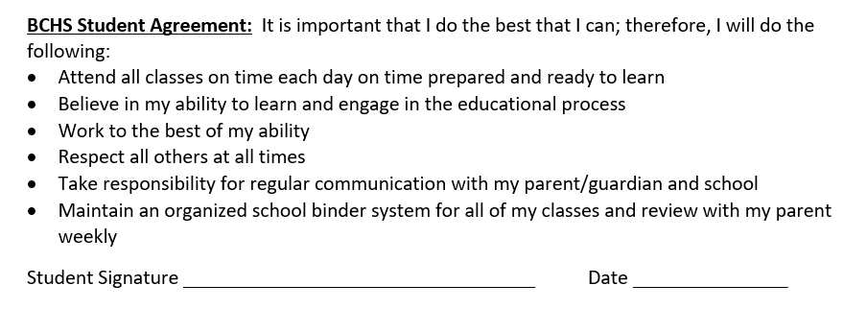

Slide 12
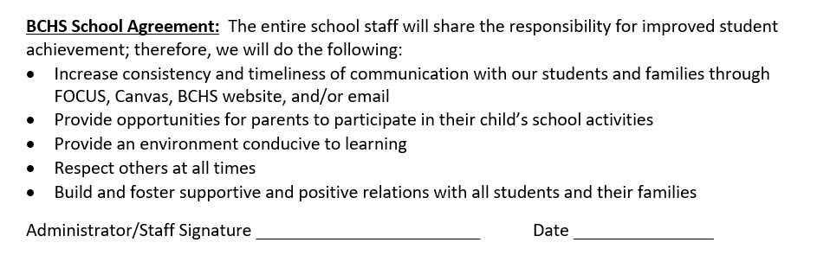

Slide 13
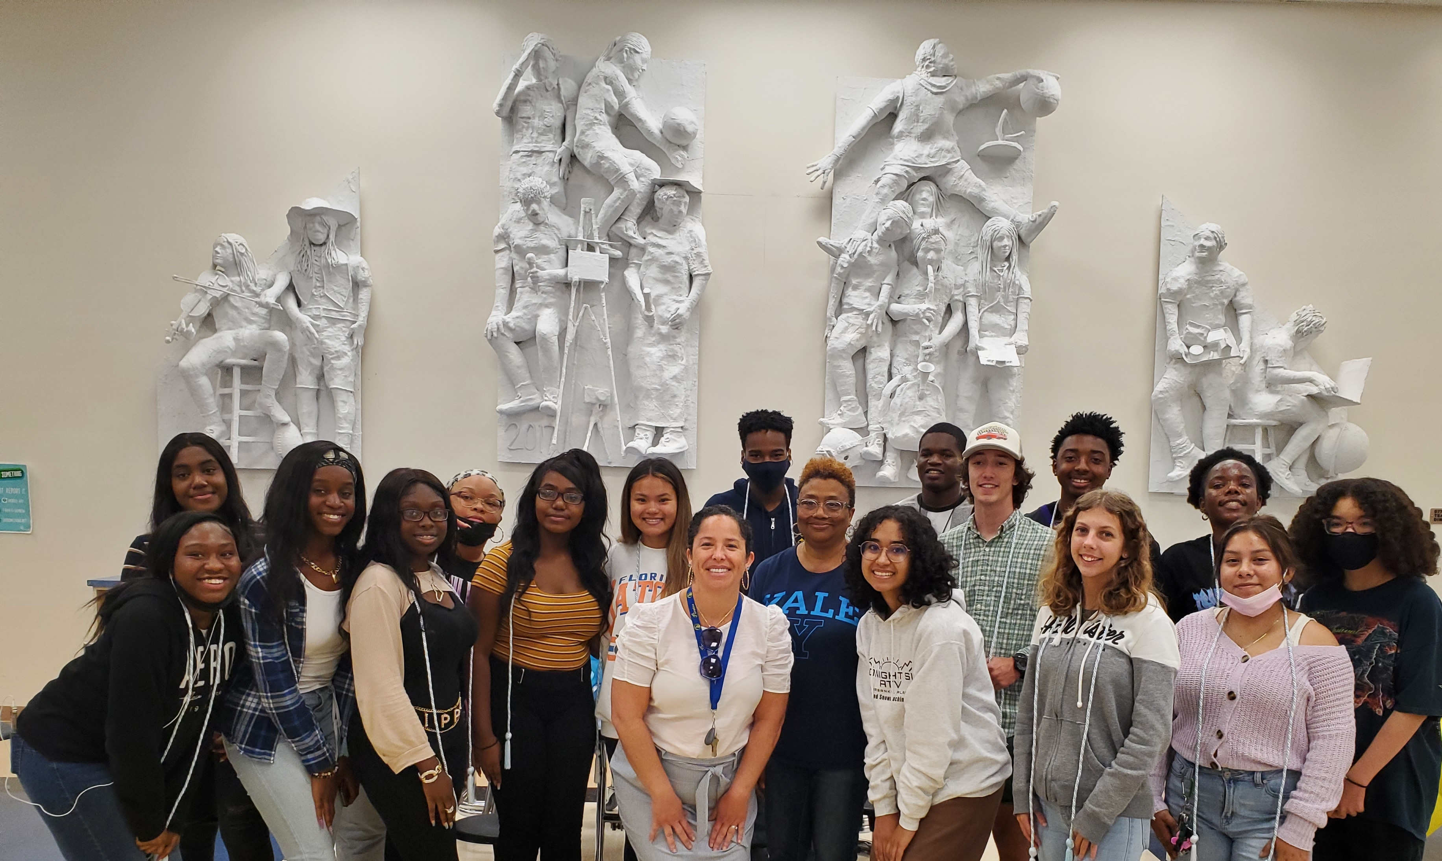
Parent and Family Engagement Plan (PFEP)
The PFEP Sections include information about the following:
  Parent trainings to increase student achievement
  Staff trainings for engaging parents
  Communication methods between home and school
  Flexible meeting times
  Accessibility for parents
  Coordinating with other Federal Programs
Notes:
Provide information on the specific committees that parents can be involved. Include the purpose, date and time of meetings.
Explain the PFEP and its purpose.
Consider the evidence related Title I Crate, Sample of Evidence,

Slide 14
Parent Advisory Council (PAC)
The District has a Parent and Family Engagement Plan. The summary of the plan is in the Title I School & Family Partnership Overview.
You may access the full plan at www.pcsb.org/titleone
The Parent Advisory Council (PAC) is responsible for reviewing and revising the District PFEP.
PAC will meet virtually or in-person with the district’s Title I staff.
Each school is committed to having at least one member representative on PAC.
PAC meets twice a year, if you are interested in representing our school please notify, Jennifer Gil at gilje@pcsb.org
Notes:
Please add your PAC representative in slide and share with your Title I Specialist.

Slide 15
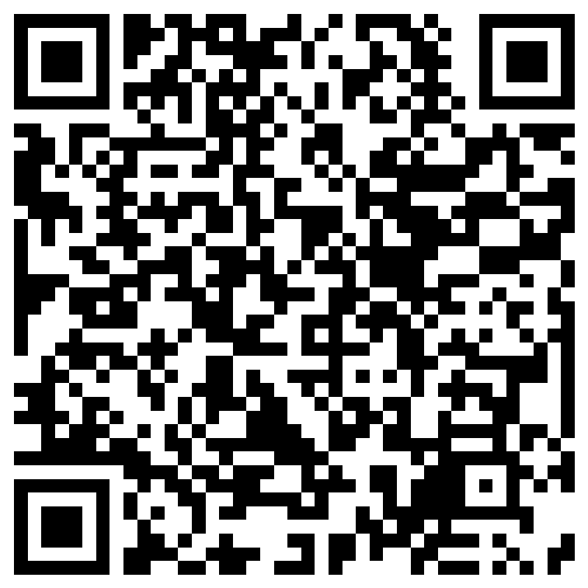
Parent Advisory Council (PAC) Interest Form
Notes:
Please complete the form if you are interested in representing your school/community.
Please allow a minute for interested families to complete the form during the meeting.
Here is the link for you to share also: https://forms.office.com/r/XYv54tECMy

Slide 16

Accountability
  School Report Cards
  School Grade and Overview
  Population and Enrollment
  Assessments – Academic Achievement, Growth, and Population
  Assessments – English Language Learners
  Graduation and Beyond
  Educator Qualifications and Equity
  Long-Term Goals and Interim Progress
  Accelerated Course Enrollment
  Per-Pupil Expenditures
  National Data
  Available online at https://edudata.fldoe.org/ or Front Office

Slide 17


Shift to New B.E.S.T. Standards
Notes:
All curriculum, instruction and assessments are based on student-centered expectations.
FSA → Transition to BEST!
https://www.flgov.com/2021/09/14/governor-desantis-announces-end-of-the-high-stakes-fsa-testing-to-become-the-first-state-in-the-nation-to-fully-transition-to-progress-monitoring/

Slide 18


Florida Benchmark For Excellent Student Thinking Standards (B.E.S.T). You may read more information by visiting, http://www.fldoe.org/standardsreview/
Notes:
All curriculum, instruction and assessments are based on student-centered expectations.

Slide 19

New Assessment: FAST
More information can be found about the FSA Transition to FAST:
https://feaweb.org/fsa-transition-to-fast/
Source: https://www.flgov.com/2021/09/14/governor-desantis-announces-end-of-the-high-stakes-fsa-testing-to-become-the-first-state-in-the-nation-to-fully-transition-to-progress-monitoring/

Slide 20
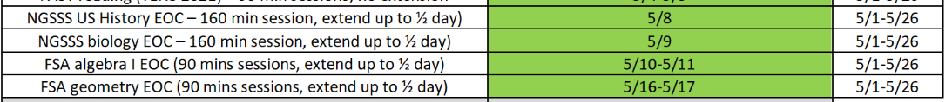
Florida End of Course (EOC)
Assessments
(Algebra 1, Biology, Civics, U.S. History, Geometry)
A full list of assessment and dates can be found on the front page of the BCHS website.
To learn more about state assessments visit the Florida Department of Education’s website, fldoe.org/accountability/assessments.
Notes:
This slide is only required, if it truly applies.

Slide 21
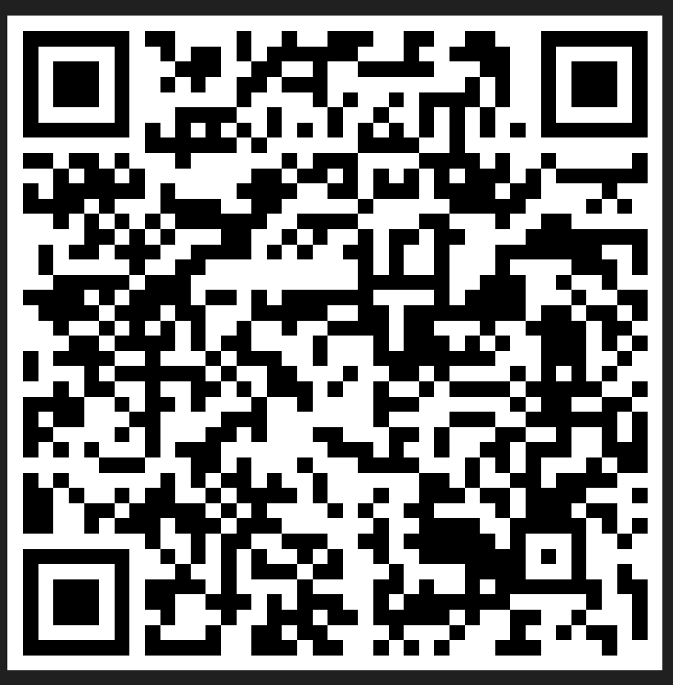
Please take the time to participate in our survey.
Your feedback is greatly appreciated!
Notes:
Please duplicate Microsoft Forms provided or create school survey. To generate a QR code hover over your school’s survey and and right click. Create QR code for this page will be an option.
https://forms.office.com/Pages/ShareFormPage.aspx?id=BZM8c9c5GkaGb_3ye_PH_x-1YNVO6C1FkgA88U6PR2tUNEQzTU0wNkZXVUxVTlpEMU81NkJFMlJNTi4u&sharetoken=FXXhmgwFjSnl0sNz61ki

Slide 22
We appreciate your time!
Please feel free to ask any questions and provide feedback on our Title I Program.

Slide 23
Recruitment Video: We Want you !
Parent Advisory Council (PAC) Video
Notes:
Please play the 1-minute video to share with families about the PAC and the interest form (which is on the next slide).

